Slide 1
Group#3
Members
Masooma Batool
Mehak Zehra
Eman Zahra
Konain Fatima
Tehseen Fatima
Shehzad Ali

Slide 2
Data Communication
Data communication is a physical transfer of data(a digital bit stream) over a point to point or point to multipoint communication channel. Communication channel is any physical media like cables etc.

Slide 3
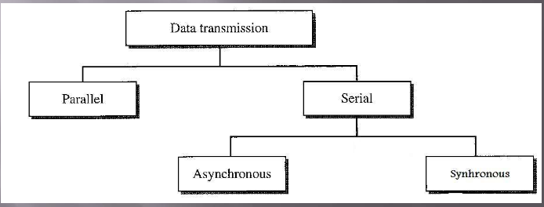
Data Communication Modes

Slide 4
Serial Communication
Transmitted serially on same wire.
Required one wire to connect.
Close or far doesn’t create any problem.
E.g. Data transmission between computer to computer.

Slide 5
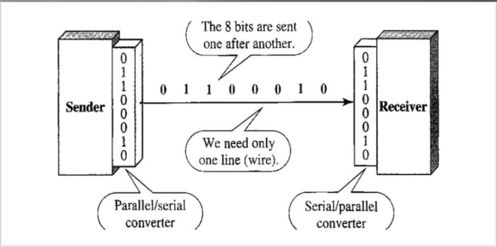
Diagrammatic representation

Slide 6
Advantages of serial communication
Serial communication can transmit data over longer distance .
Cost effective: serial communication is often less expensive then parallel .
Easy to implement.

Slide 7
Disadvantages of serial communication
Serial communication transmit data sequentially resulting and slower transfer rate.
Complex to manage data transmission and error detection .
Its typically support only a single data transfer at a time.
Limited data transfer capacity.
It can be affected by electrical noise and interfarence.

Slide 8
Serial Communication Protocol:
Protocol in serial communication refer to the set of rules that governs data transmission between devices.

Slide 9
UART (Universal Asynchronous Receiver Transmitter):
It is a serial communication protocol used for data exchange between devices. In UART, data is transmitted bit by bit asynchronously.
SPI (Serial peripheral interface):
It is a synchronous serial communication protocol that is high speed data transfer used in short distance communication. It is used for communication between multiple devices. It typically contain master device that communicate with multiple slave devices.

Slide 10
RS-422(Recommended Standard 422):
RS-422 protocol uses differential signaling for communication between devices. Differential signaling helps in reducing noise interference and allow for longer cable length.
USB (Universal serial bus):
It is widely adopted serials communication protocol that connect electronic devices .It enables plug-and-play connectivity between computer and peripheral devices.

Slide 11
Parallel communication
Parallel communication is a method of transmitting data in which multiple bits are sent simultaneously over multiple channels or cables. These bits are generally sent in data groups of 8 bits, known as bytes.
Devices close to each other.
E.g. Data transmission between computer and printer.

Slide 12
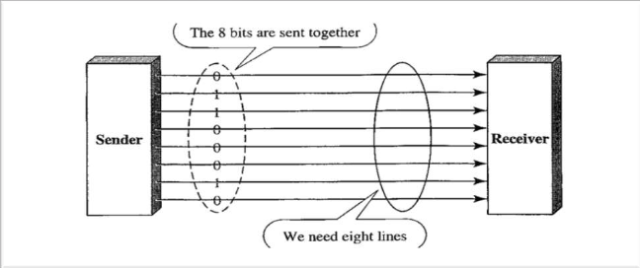
Diagrammatic Representation

Slide 13
Uses Of Parallel Communication
Parallel communication is often used in applications where high data rates are required, such as in printers, scanners, and external hard drives.
It is also used in some internal computer buses, such as the PCI bus.

Slide 14
Advantages of Parallel Communication
Higher Data Transfer Rates: Parallel communication allows multiple bits to be transmitted simultaneously, leading to higher data transfer rates compared to serial communication, especially over short distance.
Reduced Transmission Time: Since multiple bits are transmitted simultaneously, parallel communication can significantly reduce the time needed to transmit data compared to serial communication, which transmits one bit at a time.

Slide 15
Less Signal Degradation: Parallel communication is well-suited for short-distance communication, such as within a computer or between closely situated components. Over short distances, signal degradation and timing issues are minimized, making parallel communication efficient and reliable.

Slide 16
Disadvantages of Parallel Communication
Connector Complexity
Highly Cost
Time Consuming

Slide 17
Communication Protocol
A set of rules for exchanging data between computers connected to a network is called communication protocol.

Slide 18
Parallel Communication Protocol
1 ISA:
ISA stand for Industry Standard Architecture .
ISA was introduced by Mark Dean in 1992.
It is located at mother board
Functionality of ISA is connect Expansion card to ISA slot.
Example of Expansion Card is sound card ,network card and video card.
2 PCI:
PCI stand for peripheral component interconnect
PCI was introduced by intel in 1992
It is located at Mother-Board
PCI is a local computer bus standard for connecting a computer to one or more peripheral devices
Example peripheral component is sound card ,network card and video card.

Slide 19
3 MIMD:
MIMD stand for Multiple instruction , Multiple data.
Its means that execute different instruction for different data
It improve the performance of system.
4 DMA:
DMA stand for Direct Memory Access .
Direct memory access is a method that allows an input /output device to send or receive data directly from memory
This method to send or receive data directly from memory increase the memory operation speed
These process is managed by a chip known as DMAC.

